Slide 1
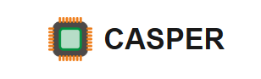

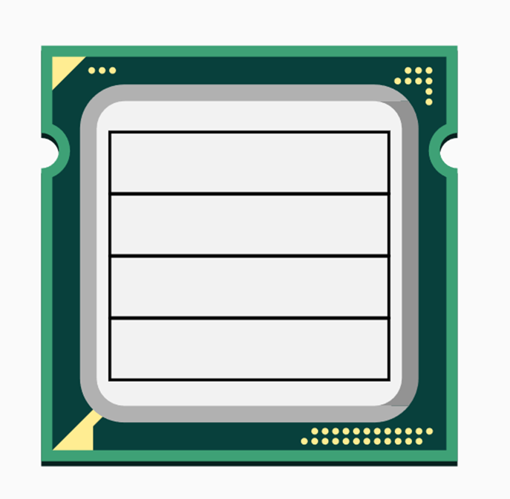

Do not Forget Hardware Prefetching While Mitigating Speculative Execution Attacks
Sumon Nath, MS@CSE-IITB CASPER Research Group
Adviser: Biswa

Slide 2



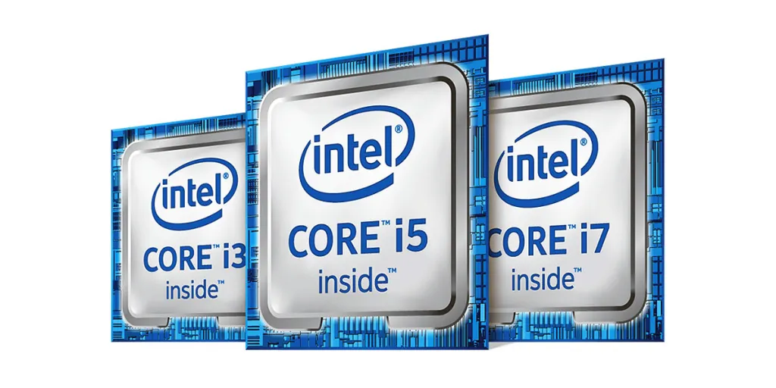


Need for Speed

Slide 3

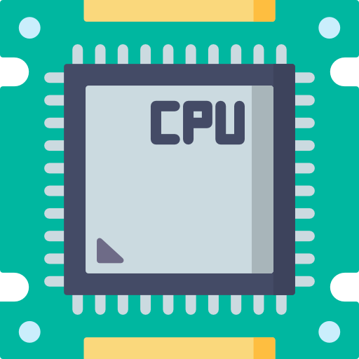


The Bottleneck
CPU frequency maxed out
Memory is slow
Notes:
Don’t speak about frequency numbers, connect the two bottlenecks

Slide 4
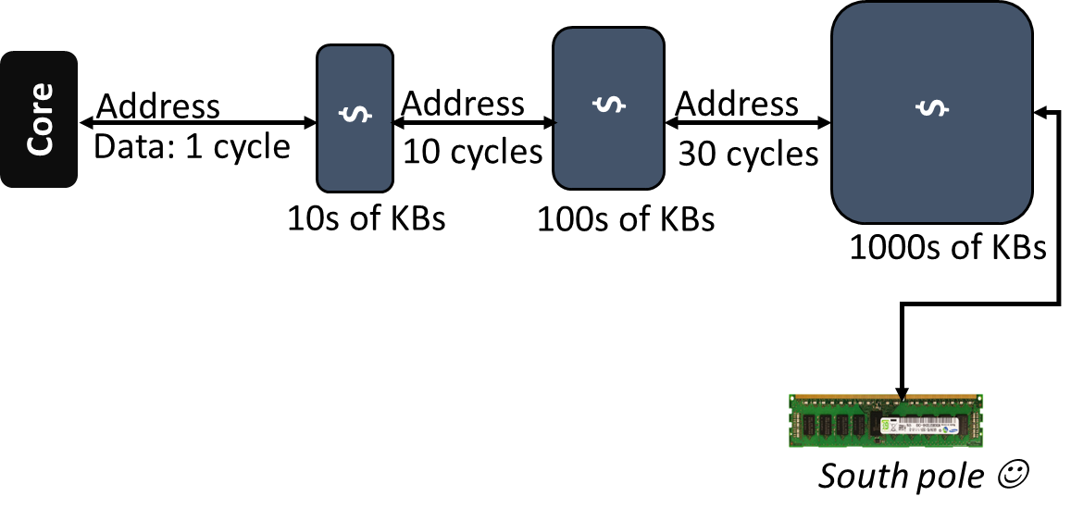
Caches: The Savior
Notes:
Simple explanation

Slide 5
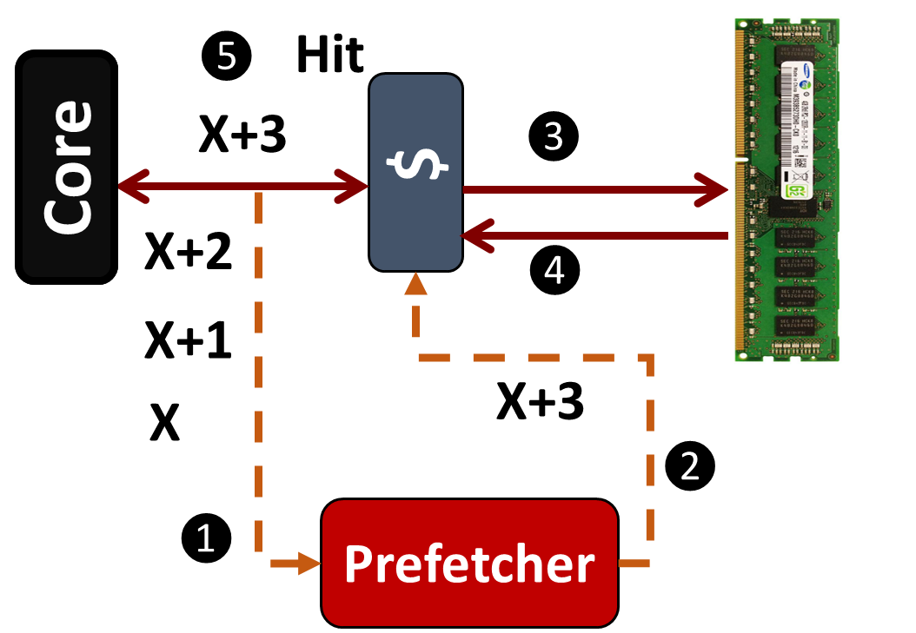

Towards 100% hit rate: Hardware Prefetching
Prefetchers improve performance by an average of 30%
Timeliness is
the key
Notes:
Timing - cover drive

Slide 6
What about security?
Notes:
Why security? ->communities focus was perf. For very long time no one talked about security.

Slide 7
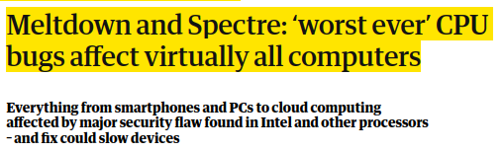


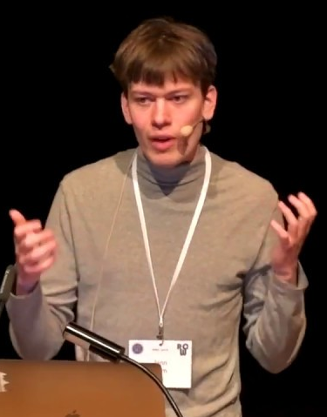
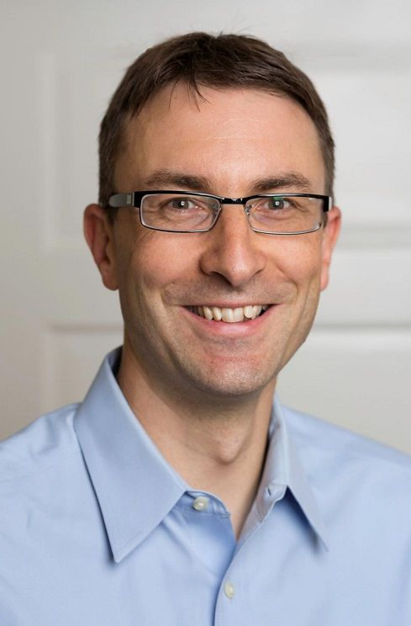
The Year 2018
Found a critical microarchitecture flaw
Flaw allowed attacker to read sensitive information from memory
Exploited Speculative execution & caches

Slide 8

In recent years: Speculative Execution Attacks
Spectre [S&P, 2019] SMoTherSpectre [CCS, 2019]
Speculative interference [ASPLOS, 2021] PacMan [ISCA 2022] Downfall [Usenix Security, 2023] Phantom [MICRO 2023]
Slam [S&P, 2024] GadgetSpinner a week ago at HPCA 2024
Notes:
Conference in architecture and security

Slide 9
Background on
Speculative Execution

Slide 10

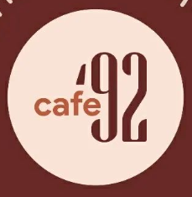
Speculative Execution
Karan
Shubham

Slide 11

Speculative Execution
Karan
Shubham

Slide 12

Speculative Execution
Karan
Shubham
Notes:
Starts preparing after seeing shubam enter cafe

Slide 13

Speculative Execution
Karan
Shubham

Slide 14


Real Processor and Branch Predictor
Similarly CPU speculates on a branch (e.g. an if condition) to gain performance
I₁
I₂
I₃
I₄
I₅
LOAD
BRANCH
SUB
ADD
Speculative instrs.
MUL
Instructions Sequence
Notes:
Starts executing instruction along the predicted path

Slide 15

Spectre in action
if (x < array1_size)
y = array2[array1[x]*2048]
x = 400 (out-of-bounds)
x = 0
h
e
l
l
o
s
e
c
r
e
t
array1
0
1
2
3
4
400
401
401
402
403
404
Notes:
Connect with google

Slide 16


Spectre in action
Wrong decision by branch predictor facilitates access of Secret
if (x < array1_size)
y = array2[array1[x]*2048]

Slide 17

Spectre in action
Wrong decision by branch predictor facilitates access of Secret
if (x < array1_size)
y = array2[array1[x]*2048]

Slide 18

Spectre in action
Wrong decision by branch predictor facilitates access of Secret
if (x < array1_size)
y = array2[array1[x]*2048]
Even though processor state is restored
Secret remains in cache for attacker to exploit

Slide 19
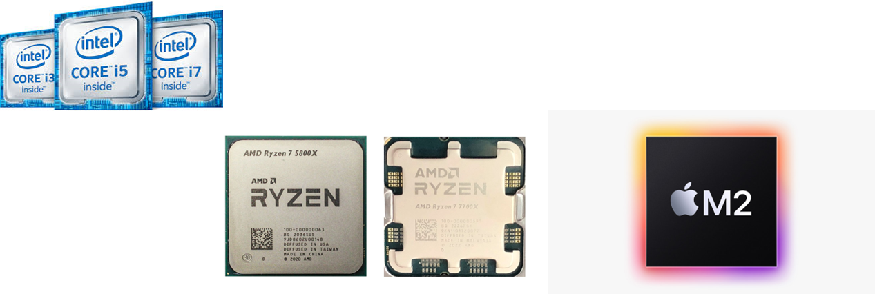

Real world attack?
It affects the world of
Intel
AMD
IBM
Apple
Qualcomm
Arm
Summary: All the processors in the world

Slide 20
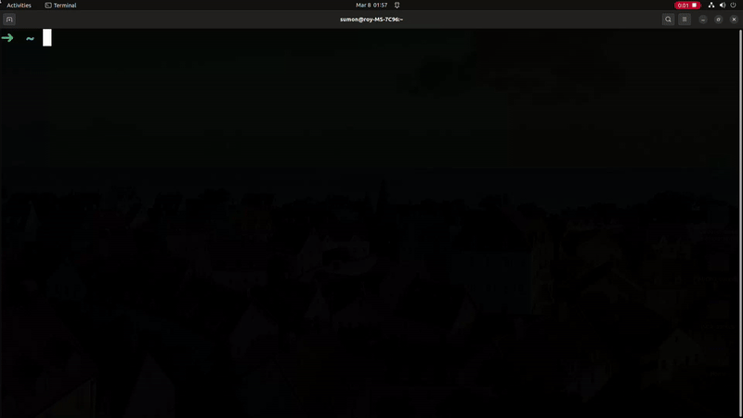
How this affects you?
Tons of software patches: costly solution: 70% performance drop

Slide 21

Microarchitecture mitigations
CleanupSpec[MICRO ‘19]
GhostMinion(GM)[MICRO ‘21]
Invisispec[MICRO ‘18]
Spec Taint Tracking[MICRO ‘19]
Time
Delay-on-miss[ISCA ‘19]
NDA[MICRO ‘19]
Degrades performance by 5 to 10% as compared to 70% (software mitigations)
Notes:
Add other mitigations too

Slide 22
The good one: GhostMinion[MICRO 2021]
CPU
L1D
GM cache
L2
GM cache
Stores all speculative data
Wiped on mis-speculation
LLC
DRAM

Slide 23
Is prefetching secure?
Train
CPU
Prefetcher
L1D
GM cache
Trigger
L2
Speculative prefetching
LLC
DRAM

Slide 24
Is prefetching secure?
Train
CPU
Prefetcher
L1D
GM cache
Trigger
Train & Trigger
On-access
When safe
L2
Speculative prefetching
LLC
DRAM

Slide 25
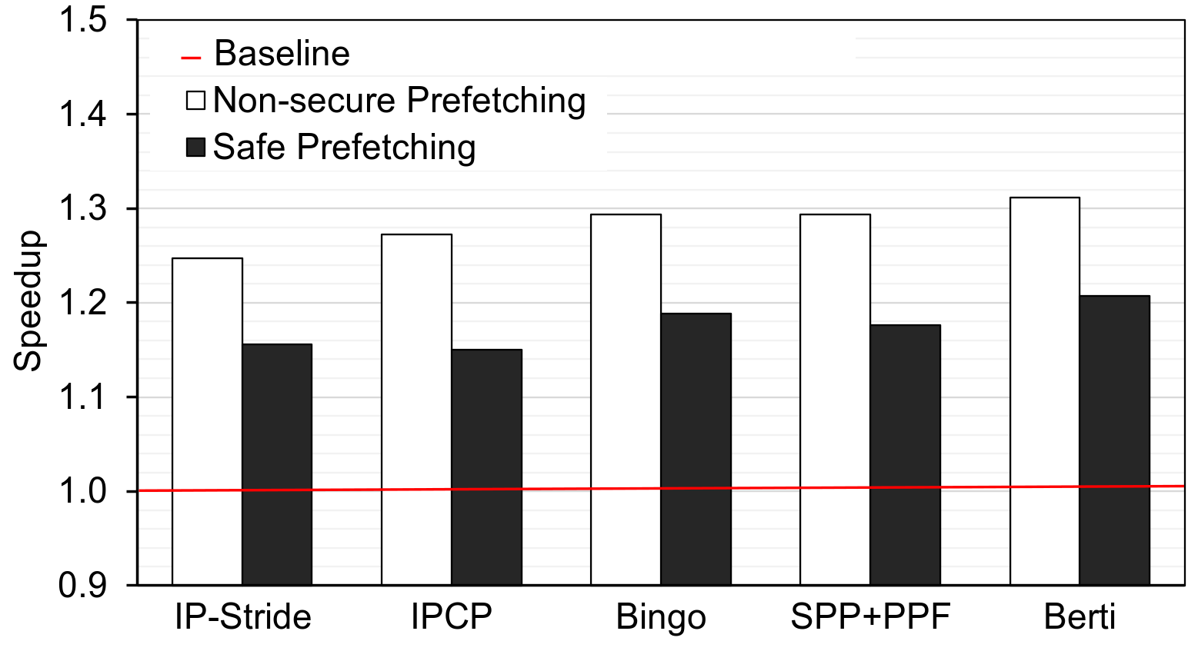
The cost of safe prefetching
11% perf. drop
Intel and AMD spent three years to get 3% improvement
Notes:
Put arrows between white bar and black bar in Berti

Slide 26


The tradeoff: Performance and security
Conflicting tradeoffs
Looks like a challenging problem to solve
Notes:
Put Security in the left balance,.....................Last slide should be balanced

Slide 27
Our work

Slide 28
Our goal, insights and contributions
Can we design secure prefetcher that can work synergistically with secure cache system, without losing performance?
Negative impact of secure cache system on prefetching
(Memory traffic)
Secure update filter (SUF)
Timeliness issues with
secure prefetching
Timely secure Berti (TSB)

Slide 29


SUF + TSB in nutshell
CPU
Prefetcher
L1D
GM cache
L2
Timeliness issue
Increased memory traffic
TSB
LLC
SUF
DRAM

Slide 30
Key Results
Proposals | Performance | Storage | Security?
GM [MICRO 2021] | -11% | 2.40 KB | Yes
SUF + TSB [ISCA 2024*] | +16% | 2.87 KB | Yes
We do not prefetch and interact with cache speculatively. So by definition we are still secure.

Slide 31
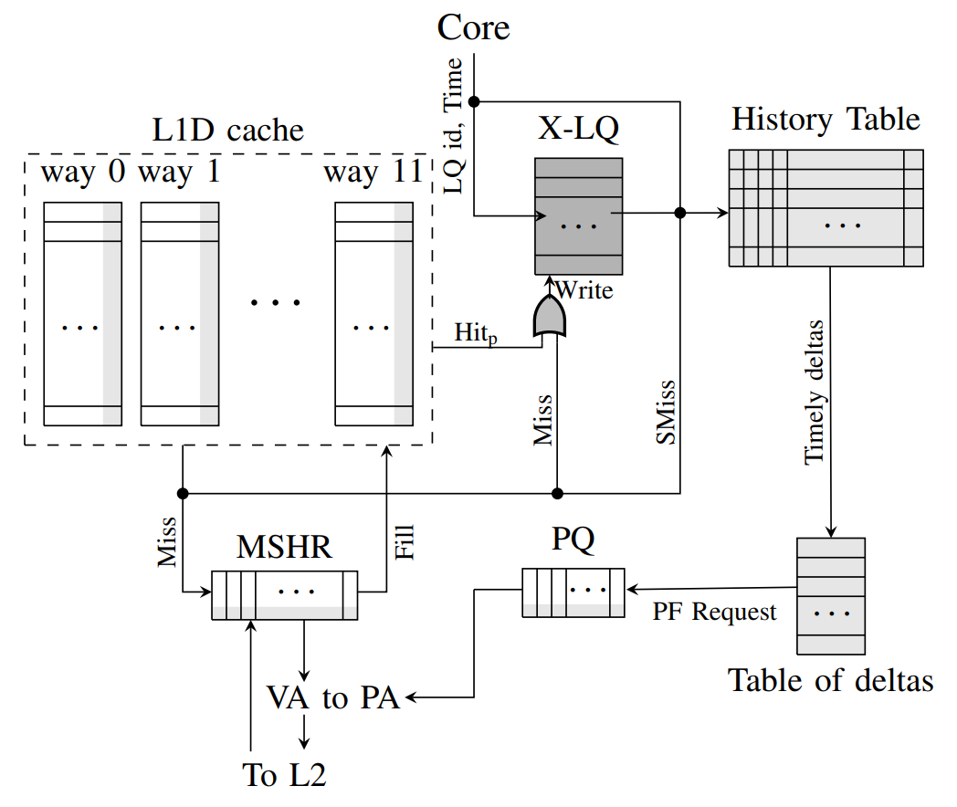
For Microarchitecture Ninjas
Modifications in grey

Slide 32



Key takeaways
Secure cache systems hinder prefetcher performance
(conflicting tradeoffs)
Prefetchers not designed keeping Spectre attack in mind
First work that provides a
win-win trade off
Work under submission at ISCA 2024 (flagship forum in the field of computer architecture)

Slide 33
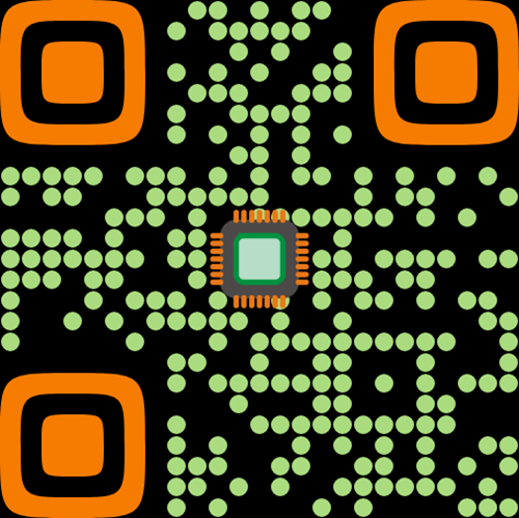

Thanks and questions
Feel free to email us for more queries and questions
sumon@cse.iitb.ac.in
biswa@cse.iitb.ac.in
Images Flaticon

Slide 34
Devil is in the details
CPU
Speculative path
Commit Write – hit in GM
Commit Load – miss in GM
Re-fetch
L1D
GM
Writeback
Cache state untouched
LRU bits not updated on hit
Bypass fills to L1/L2/LLC
L2
LLC
Caches updated On-commit
Writeback to L1-> L2 -> LLC
Re-fetch to L1
DRAM

